Slide 1
The Road to the Civil War

Slide 2
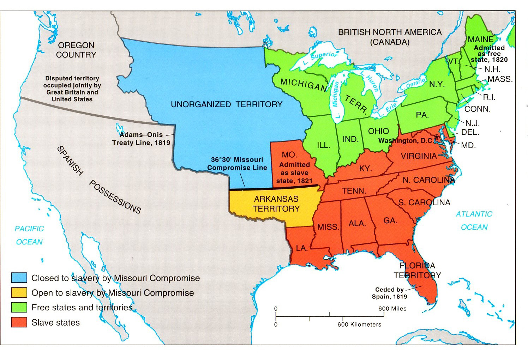
North vs. South
The tensions between Northern and Southern states had always existed
3/5 Compromise
State vs. Federal Control
Agriculture vs. Industry
Slavery vs. Free
Balance in the Senate
Missouri Compromise
But with the conflict between the two groups came to a head following the Mexican War and the question of how the new territories will enter into the Union.
Slavery in the new territories became a federal issue as opposed to a state controlled one

Slide 3
Slavery in the New Territories
X
The Missouri Compromise did not state whether or not slavery would be allowed in new territories.
Some northern senators tried to pass the Wilmot Proviso- which stated that all of the new territory gained from Mexico would be off limits to slavery
Rejected IMMEDIATELY the slave states in the Senate

Slide 4
California?
As discussed earlier, did people living in California want slavery?
No, most were poorer prospectors/farmers/ immigrants that did not have slaves
How to deal with these arguments is going to be the last contribution from the Great Triumvirate.
Calhoun threatens to secede once again if the federal government refuses to recognize ‘property’ rights of southern planters

Slide 5
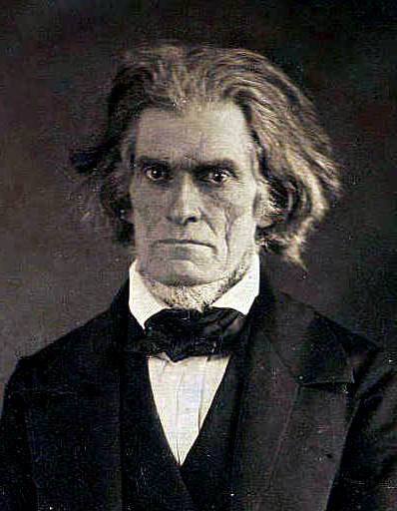
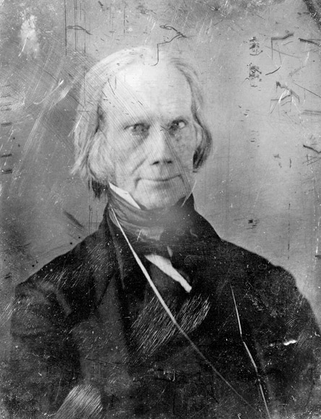
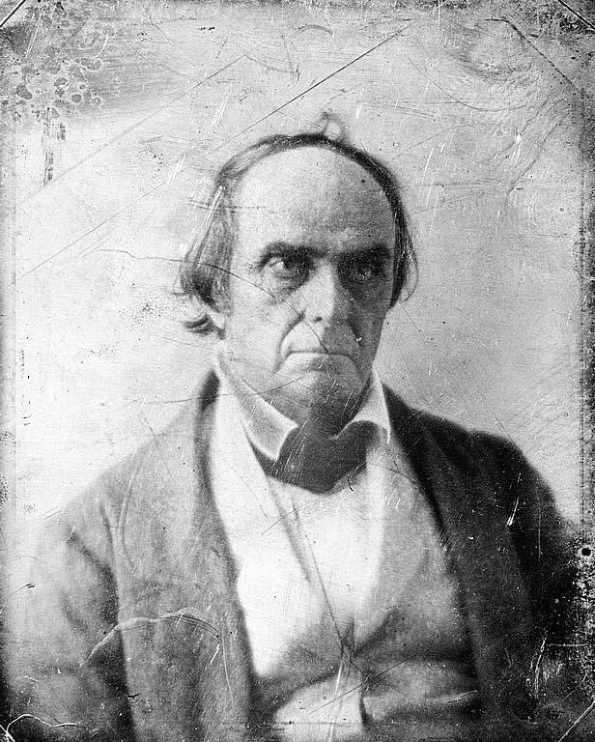
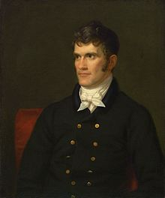
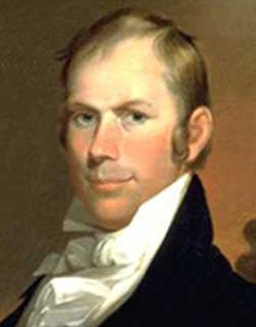
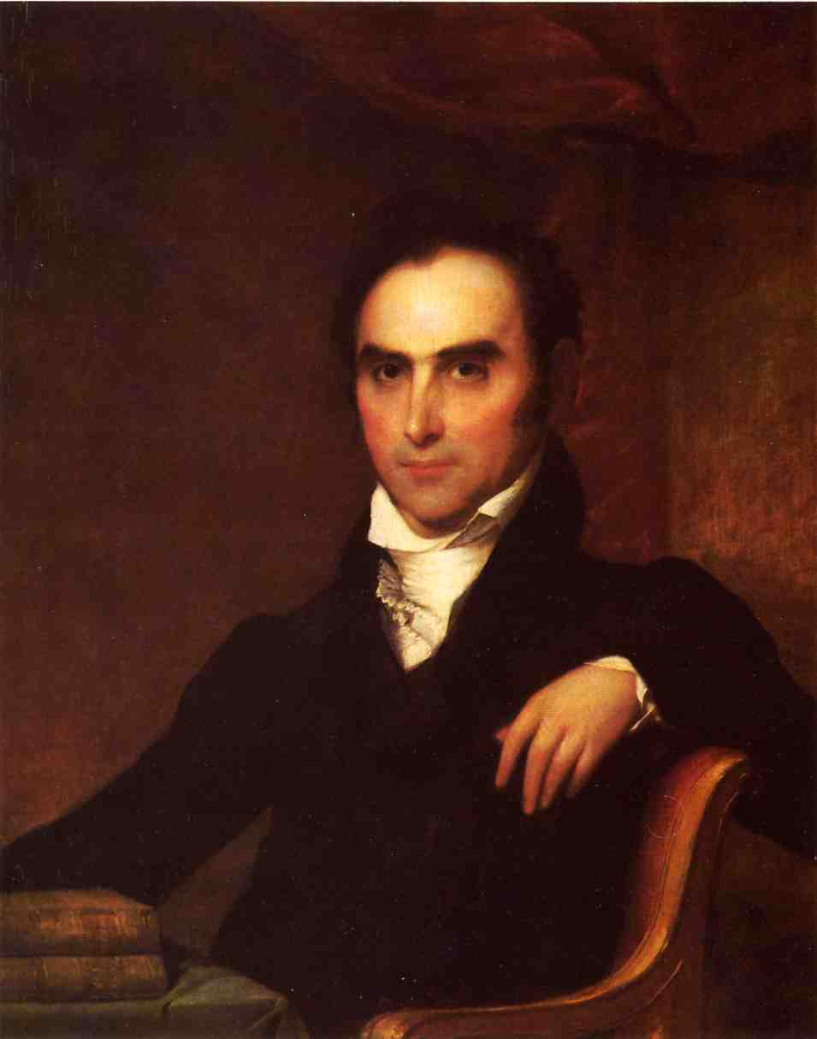

Slide 6
Compromise of 1850
Henry Clay, “The Great Compromiser” tries to make both sides happy one more time.
North:
California is Free
No slave trade allowed in D.C.
South
Allows for popular sovereignty in new territories
People living there get to decide
New Fugitive Slave Law

Slide 7
Fugitive Slave Law
As a concession to the South, a very strict federal slave law went into effect
Slave catchers from the south can now take any African (slave or free) that they thought was a runaway
Accused were not given a trial by jury
All U.S. citizens were now required to help slave catchers

Slide 8
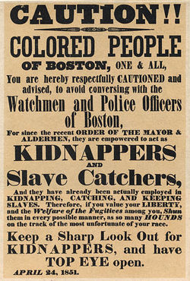
Fugitive Slave Law
Northerners were OUTRAGED!
Many states had never had slavery before in their borders and now they be being told that they have to actively support the institution
Attacks on slave catchers were common
Abolition movement grew as more and more people became convinced that slavery was evil

Slide 9
Uncle Tom’s Cabin
Attitudes towards slavery continue to worsen in the North with the publication of the best selling novel of the century, Uncle Tom’s Cabin, by abolitionist Harriet Beecher Stowe
The novel tells the story of a kind old slave named Uncle Tom who is beaten to death by a cruel master
HOW DO YOU THINK THE STORY WILL BE RECEIVED IN THE SOUTH?

Slide 10
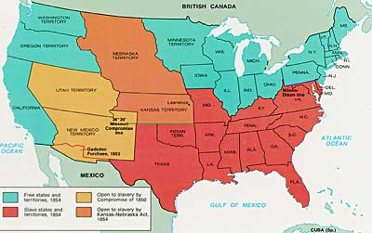
Kansas-Nebraska Act
Conditions worsen when Illinois Senator Stephan Douglas, in an attempt to begin construction on the Transcontinental Railroad, proposes a new piece of legislation Kansas-Nebraska Act
Revokes the Missouri Compromise when he opens the territories of Kansas and Nebraska, that had been closed off to slavery, to the idea of popular sovereignty
WHICH SECTION IS GOING TO LIKE/DISLIKE THIS ACTION BY DOUGLAS?

Slide 11
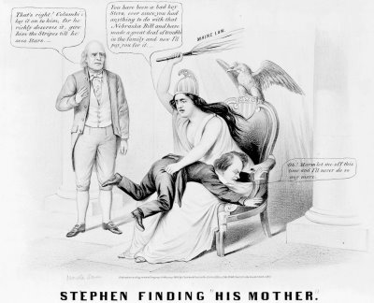

Slide 12
Since Kansas’ entrance into the Union will be based on popular sovereignty what will abolitionists and pro-slavery forces be motivated to do?
Both sides will be flooding into Kansas to make sure that their side has the superior numbers and to intimidate the opposition.

Slide 13
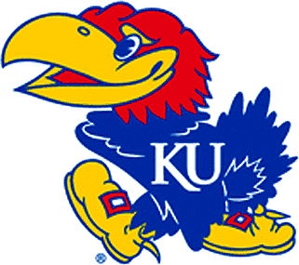
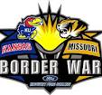
“Bleeding Kansas”
Inevitably conflicts break out between the two factions
Anti-Slavery Jayhawks
Pro-Slavery: ‘Tigers’ from Missouri
Fraud on election day
8,000 votes cast when population of Kansas was around 3,000
Quickly turns to violence with slavery forces attacking well known abolitionists and the anti-slavery sides retaliating
John Brown: most famous of the participants in “Bleeding Kansas.” Slaughtered several pro-slavery settlers.

Slide 14
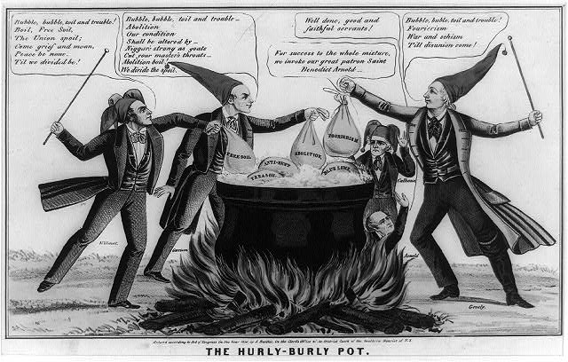

Slide 15
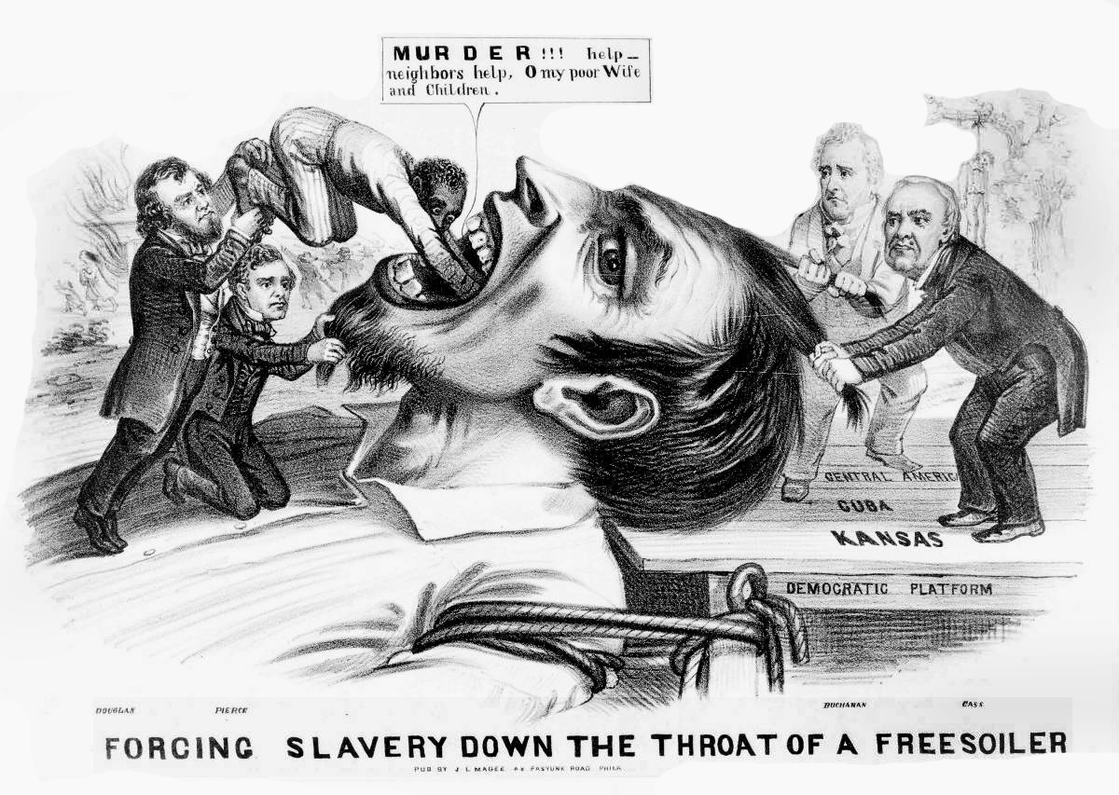

Slide 16
“Bleeding Kansas”
News of carnage in Kansas also created violence in the U.S. Senate
When a Northern senator criticized the South and a South Carolina Senator in particular, the nephew of the insulted Southerner attacked him with a cane

Slide 17
Dred Scott Decision
Relationships continued to worsen with the passage of the Supreme Court decision of the Dred Scott Decision
Slave who tried to sue for his freedom since he lived in Wisconsin and Illinois
Court replied that Scott couldn’t even sue since no African Americans were citizens
Also slaves were property and the Constitution protects property
Results in outrage in the North
Supreme Court essentially said there is no such thing as a free state!

Slide 18
Dred Scott Decision
“This very attempt to blot out forever the hopes of an enslaved people may be one necessary link in the chain of events leading to the downfall and complete overthrow of the whole slave system.”
What is Douglass saying about the Dred Scott Decision?
This ruling is SO BAD that many people will finally act against slavery.

Slide 19
John Brown’s Raid
Feeling that the question of slavery will never be dealt with except with violence, John Brown planed to raid the federal arsenal at Harper’s Ferry and lead an armed slave revolution throughout the south
What do you think, should people take up arms against the government if they feel they should be following more moral laws?

Slide 20
John Brown’s Raid
Brown’s slave rebellion never occurred and he is captured by U.S. Marines
Tried and convicted for treason and murder and is hanged.
North: martyr and hero
South: terrorist
What do you think John Brown was?

Slide 21
Election of 1860
In the midst of all the chaos, a new political party had emerged, the distinctly anti-slavery party, the Republicans.
For the 1860 Presidential election they nominated Abraham Lincoln
Politically inexperienced
Intelligent/self taught
Brilliant speaker
Anti-slavery advocate
Would allow slavery to continue in states, but NOT extend into new territories

Slide 23
Lincoln carries all of the free states, much to the dismay of the south.
Republican Party and Lincoln weren’t even on the ballot of several southern states
Southerners believed that the election of Lincoln was the last straw; that he would end slavery everywhere.

Slide 24
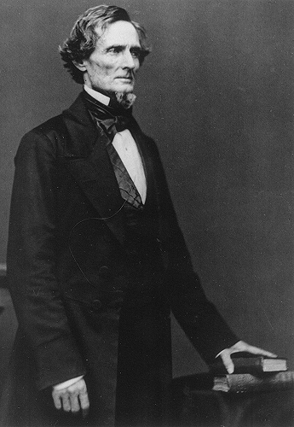
Confederate States of America
When news of Lincoln’s election reached South Carolina, they immediately called for secession.
This time they are not alone, 6 more southern states also leave the union
These states meet together and agree to form their own nation: the Confederate States of America (CSA)
Elect Jefferson Davis as President

Slide 25
Lincoln is Inaugurated
When Lincoln takes the oath of office, he is at the head of a broken nation.
His main concern would be restoring the Union
Would allow slavery to continue where it was if it would keep the states together.

Slide 26
Civil War Begins
CSA does not trust Lincoln’s promises of friendship and begin seizing federal forts
Fort Sumter in Charleston, S.C. is most crucial
U.S. officer refuses to surrender and is being starved out
On April 12, 1861 Confederates fire on the fort, and after 2 days of shelling, Sumter surrenders and the Civil War has begun.

